Slide 1


Library management System
Subject: Database Management System (CSA0506)
A Technical presentation by
Aameena. I (192511284)
Under the guidance of,
Dr. Hemavathi

Slide 2
INTRODUCTION
An Entity Relationship (ER) Diagram is a graphical representation of a database.
It shows entities, their attributes, and the relationships between them.
In an Library management System, the ER diagram helps organize information about books, members, librarians, and borrowing records.
It provides a clear blueprint for designing an efficient and well-structured database.

Slide 3
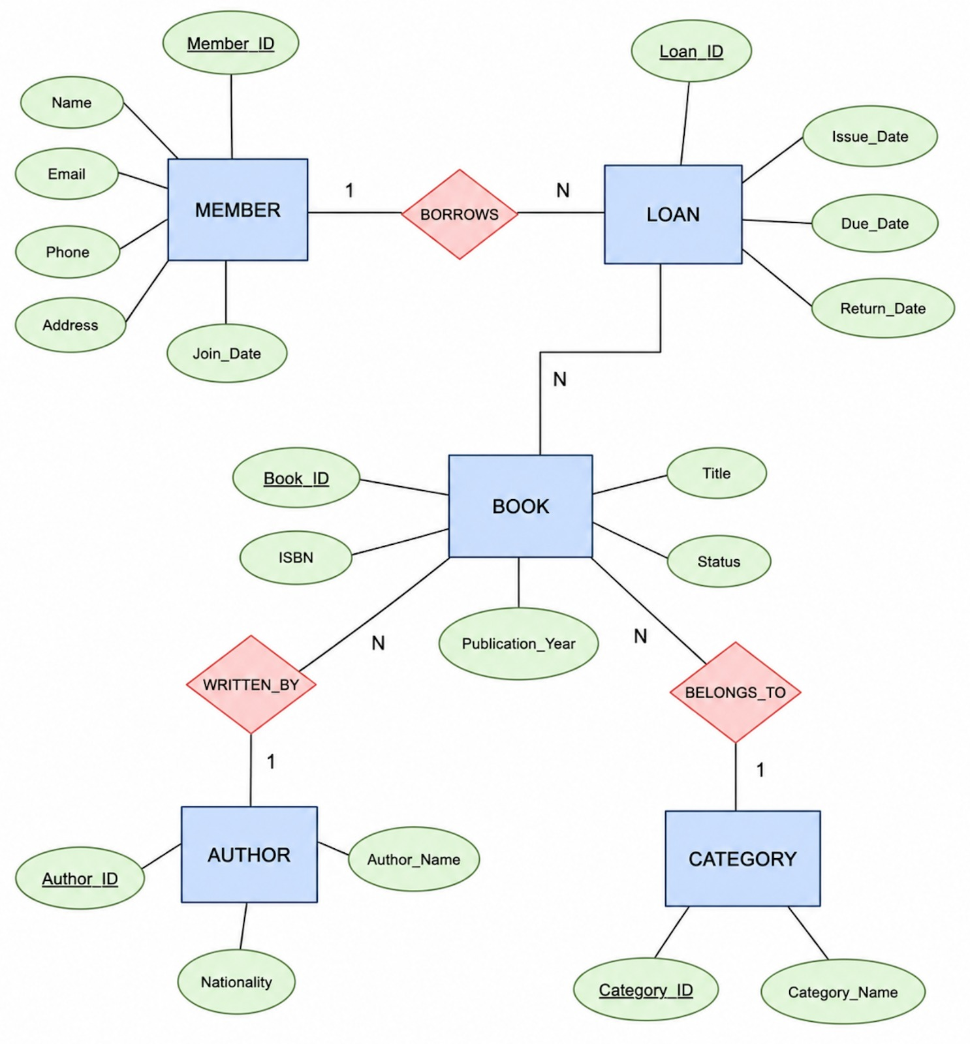

Slide 4
Entities
Member – Stores member details.
Book – Stores book information.
Loan – Stores book issue and return records.
Author – Stores author information.
Category – Stores book categories.

Slide 5
Relationships
Member BORROWS Loan (1 : N) One member can have multiple loan records.
Loan contains Book (N : 1) Each loan is for one book.
Book WRITTEN_BY Author (N : 1) One author can write many books.
Book BELONGS_TO Category (N : 1) One category contains many books.

Slide 6
NOTE
Entities: Objects stored in DB.
Attributes: Properties of entities.
Relationships: Connections between entities.
Primary keys uniquely identify records.

Slide 7
Thank You

